Slide 1
Math 152 – Lesson 3
Lesson | Topic | Reading
2 | The Definite Integral | 5.2
3 | Approximate Integration | 7.7
4 | Antiderivatives | 4.9
Objectives:
Use SIMPSON'S RULE to estimate definite integrals
Know whether RHS/LHS/Trap/MP will be an over or under estimate based on slope and concavity
Use the Trapezoid Rule to estimate definite integrals

Slide 2
Why Approximate?
Sometimes if is difficult or impossible to find antiderivative
There is no formula for the function, it is collected through scientific experiment/instrument readings

Slide 3
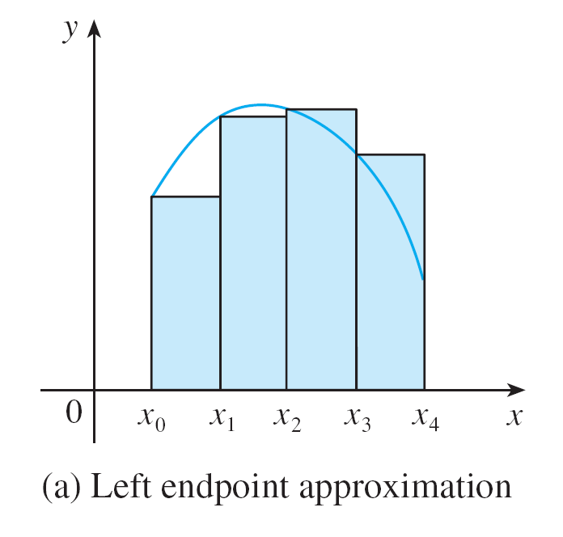
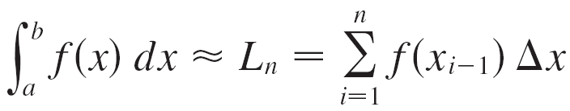
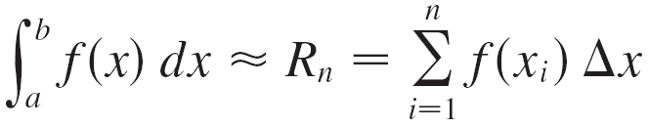

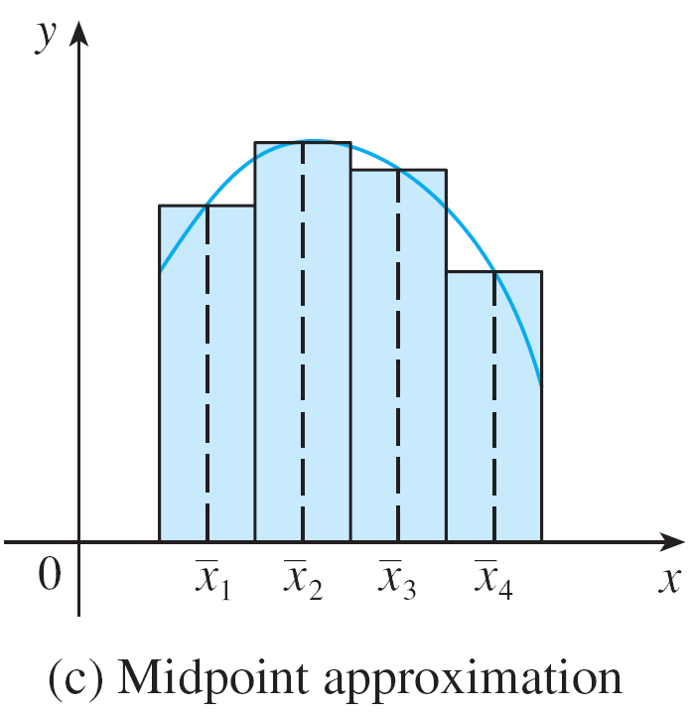
Ways to Approximate

Slide 4
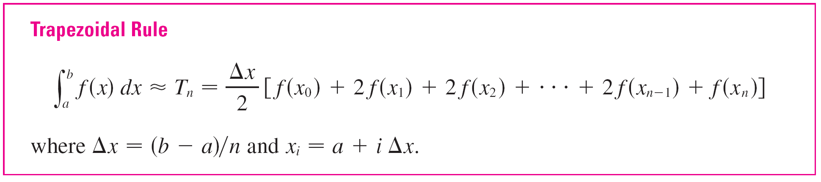
Ways to Approximate Cont
n=4 intervals
Note: n+1 evaluations

Slide 5
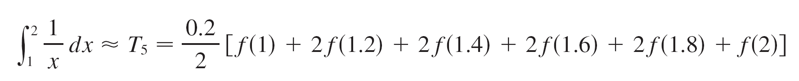
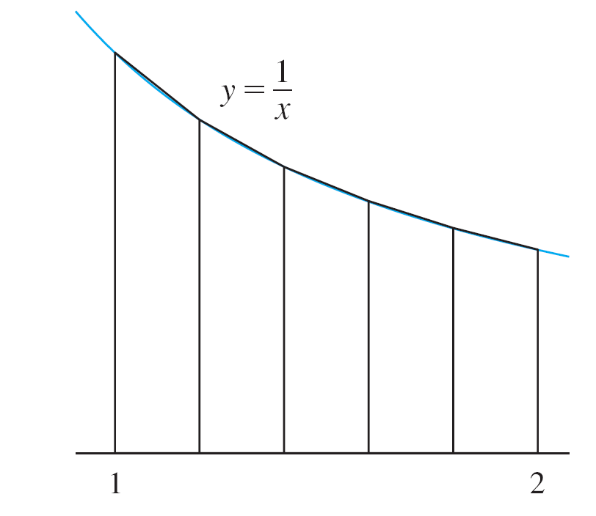
Example 1
Use n = 5 to approximate the integral
(a) the Trapezoidal Rule
(b) the Midpoint Rule with
Solution:
(a) With n = 5, a = 1 and b = 2 => Δx = (2 – 1)/5 = 0.2
≈ 0.695635

Slide 6
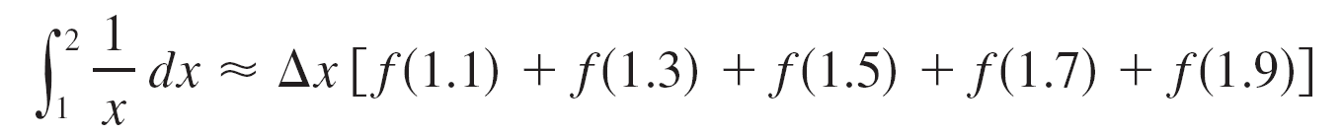
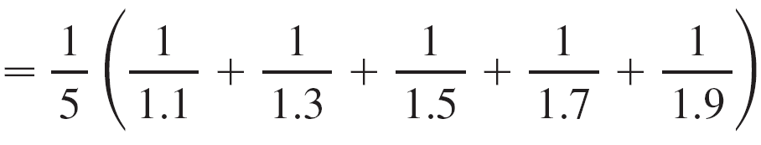
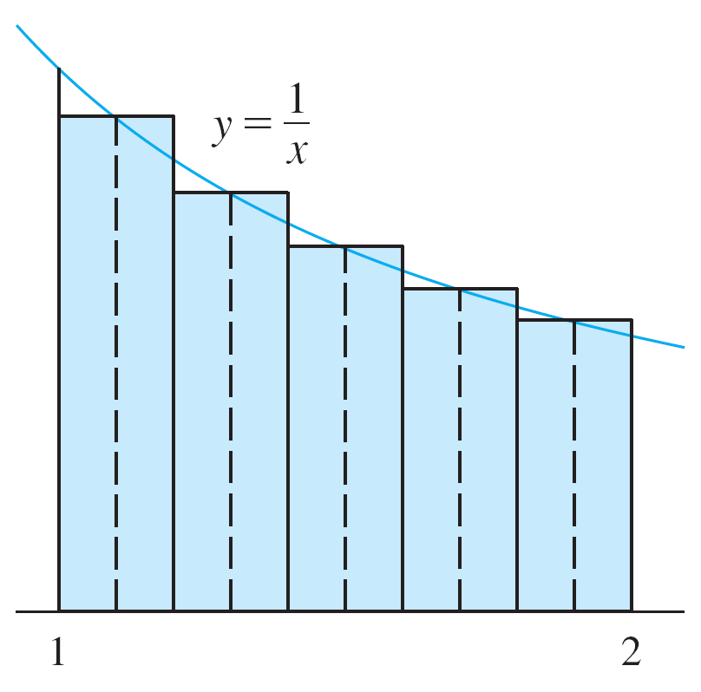
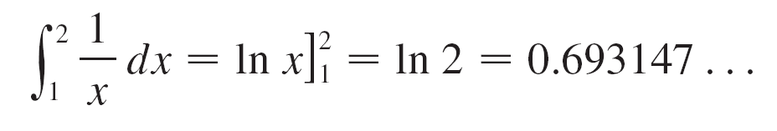
Example 1 – Solution
cont’d
(b) The midpoints of the five subintervals are 1.1, 1.3, 1.5, 1.7, and 1.9, so the Midpoint Rule gives
≈ 0.691908
Figure 4

Slide 7
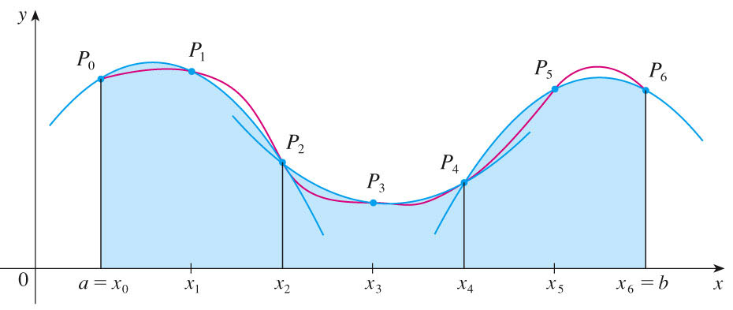

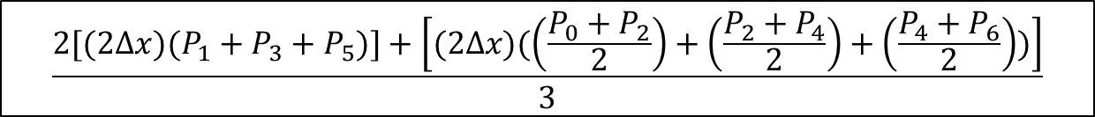

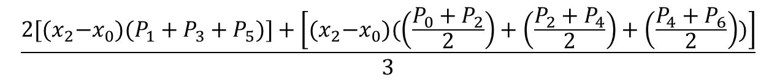
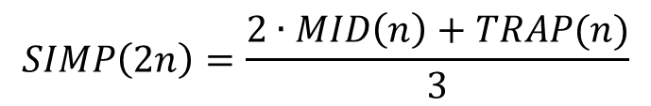
Simpson’s Rule
Combining Left and Right estimates Gave us a better estimate using Trapezoids
Simpson’s rule combines Trap and Mid to give an even better estimate using parabolas
$$SIMP\left(2n\right)=\frac{2∙MID\left(n\right)+TRAP(n)}{3}$$
$let ∆x={(x}_{1}−x_{0}$)
$$\frac{2[{(x}_{2}−x_{0})(P_{1}+P_{3}+P_{5})]+\left[{(x}_{2}−x_{0})(\left(\frac{P_{0}+P_{2}}{2}\right)+\left(\frac{P_{2}+P_{4}}{2}\right)+\left(\frac{P_{4}+P_{6}}{2}\right))\right]}{3}$$
$$\frac{2[(2∆x)(P_{1}+P_{3}+P_{5})]+\left[(2∆x)(\left(\frac{P_{0}+P_{2}}{2}\right)+\left(\frac{P_{2}+P_{4}}{2}\right)+\left(\frac{P_{4}+P_{6}}{2}\right))\right]}{3}$$
$$\frac{2[(2∆x)(P_{1}+P_{3}+P_{5})]+\left[(2∆x)(\left(\frac{P_{0}}{2}\right)+P_{2}+P_{4}+\left(\frac{P_{6}}{2}\right))\right]}{3}$$
$$\frac{[(4∆x)(P_{1}+P_{3}+P_{5})]+\left[(∆x)(P_{0}+{2P}_{2}+{2P}_{4}+P_{6})\right]}{3}$$
$SIMP\left(6\right)=\frac{∆x}{3}$[$P_{0}$+${ 4P}_{1}+{2P}_{2}$ + ${4P}_{3}+{2P}_{4}$ + ${4P}_{5}+P_{6}$]
Notes:
P513
Approximate integration technique using 3 points to define a parabola.
$SIMP\left(n\right)=$ $\frac{∆x}{3}$[$P_{0}$+${ 4P}_{1}+{2P}_{2}$ + ${4P}_{3}+{2P}_{4}$ + ${4P}_{5}+P_{6}$]
Which turns out to be the same as $SIMP\left(2n\right)=\frac{2∙MID\left(n\right)+TRAP(n)}{3}$, where in this case 2n = 6, so n=3 divisions
This example takes the $SIMP\left(2n\right)=\frac{2∙MID\left(n\right)+TRAP(n)}{3}, where n=3,$and works it backwards to arrive at
$SIMP\left(n\right)=$ $\frac{∆x}{3}$[$P_{0}$+${ 4P}_{1}+{2P}_{2}$ + ${4P}_{3}+{2P}_{4}$ + ${4P}_{5}+P_{6}$], where n = 6
Don’t stress memorizing this one

Slide 8
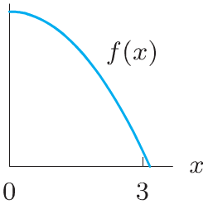
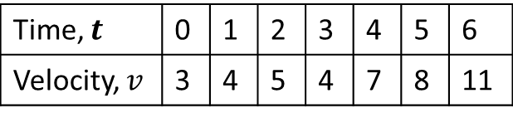
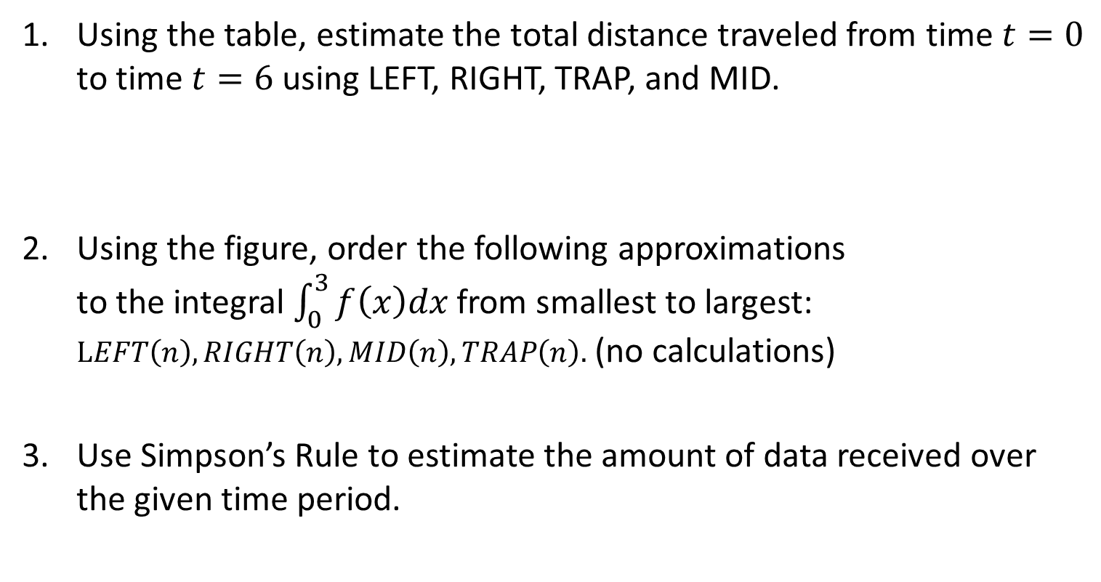
Board Work
Using the table, estimate the total distance traveled from time $t=0$ to time $t=6$ using LEFT, RIGHT, TRAP, and MID.
Using the figure, order the following approximations to the integral $\int_{0}^{3}{f\left(x\right)dx}$ from smallest to largest: $LEFT\left(n\right), RIGHT\left(n\right), MID\left(n\right), TRAP\left(n\right).$ (no calculations)
Use Simpson’s Rule to estimate the amount of data received over the given time period.
Time, $t$ | 0 | 1 | 2 | 3 | 4 | 5 | 6
Velocity, $v$ | 3 | 4 | 5 | 4 | 7 | 8 | 11
Time (hrs) | 0 | 0.5 | 1 | 1.5 | 2 | 2.5 | 3
Data rate (Mb/sec) | 0.5 | 0.68 | 0.42 | 0.33 | .25 | .56 | .7

Slide 9
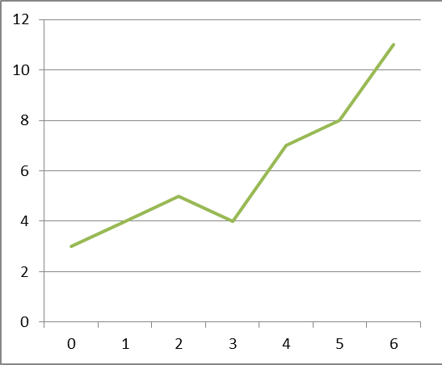
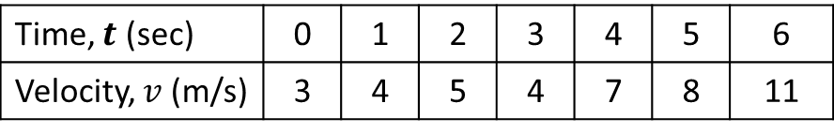

Solution 1
Using the table, calculate the best estimate for the total distance traveled from time $t=0$ to time $t=6$ using LEFT, RIGHT, TRAP, and MID.
Time, $t$ (sec) | 0 | 1 | 2 | 3 | 4 | 5 | 6
Velocity, $v$ (m/s) | 3 | 4 | 5 | 4 | 7 | 8 | 11

Slide 10
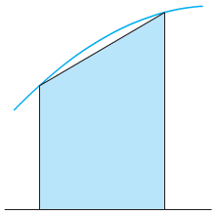
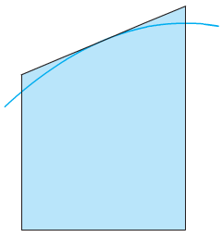

Solution 2
Using the figure, order the following approximations to the integral $\int_{0}^{3}{f\left(x\right)dx}$ and its exact value from smallest to largest: $LEFT\left(n\right), RIGHT\left(n\right), MID\left(n\right), TRAP\left(n\right), Exact value.$
f Concave Down
Trapezoid Underestimates
f Concave Down
Midpoint Overestimates
RHS
EXACT
LHS
TRAP
MP
Under Est
Over Est
Notes:
7.7#2…f(x) is concave UP…R<M<exact<trap<L

Slide 11
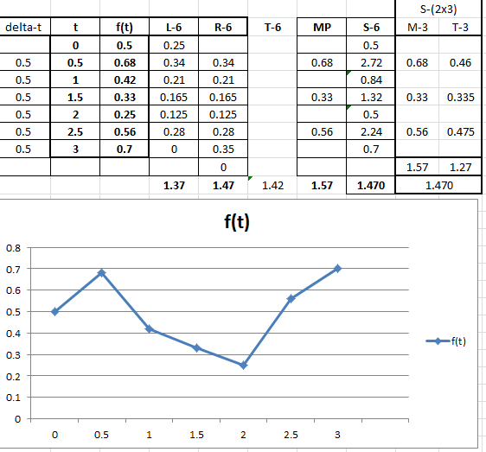
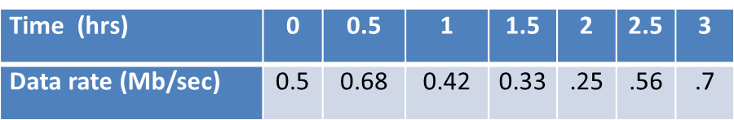
Solution 3
( + )
( - )
( + )

Slide 13
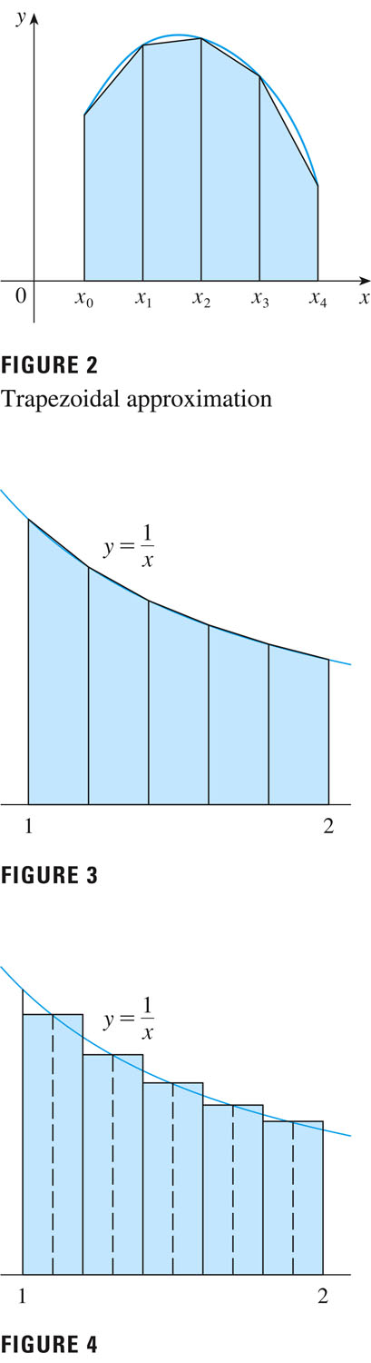

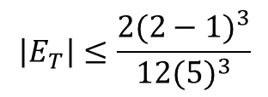

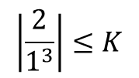

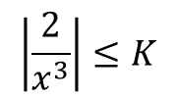

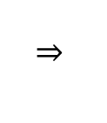
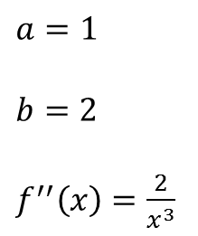

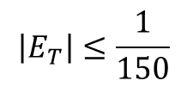
Error Bounds
$$Error = Actual – Estimate$$
$$If:$$
$$a≤x≤b$$
$$\left|f′′(x)\right|≤K$$
$$\left|E_{T}\right|≤\frac{K{(b−a)}^{3}}{12n^{3}}$$
$$Then:$$
$$\left|\frac{2}{x^{3}}\right|≤K$$
$$\left|\frac{2}{1^{3}}\right|≤K$$
$a=1$
$b=2$
$f^{′′}\left(x\right)=\frac{2}{x^{3}}$
$$\left|E_{T}\right|≤\frac{2{(2−1)}^{3}}{12{(5)}^{3}}$$
$$\left|E_{T}\right|≤\frac{1}{150}$$
Notes:
Have them read 510 for midpoint bound
No reason to calculate an estimate if you have the actual, but if you know the acceptable error, then you know the required accuracy

Slide 14











Derivatives
Rules | Properties
Constant | Constant Multiple
Power | Sum/Diff
Exponential | L’Hospital’s Rule
Product
Quotient
Trigonometric
Chain Rule
Logarithmic
$$\frac{d}{dx}\left(c\right)=0$$
$$\frac{d}{dx}[cf\left(x\right)]=c\frac{d}{dx}f(x)$$
$$\frac{d}{dx}\left(x^{n}\right)=nx^{n−1}$$
$$\frac{d}{dx}\left[f\left(x\right)±g\left(x\right)\right]=\frac{d}{dx}f\left(x\right)±\frac{d}{dx}g\left(x\right)$$
$$\frac{d}{dx}a^{x}={ln⁡(a)∙a}^{x}$$
$$\lim_{x→a}{\frac{f(x)}{g(x)}}=\lim_{x→a}{\frac{f′(x)}{g′(x)}}$$
$$\frac{d}{dx}\left[f\left(x\right)g\left(x\right)\right]=g\left(x\right)\frac{d}{dx}f\left(x\right)+f(x)\frac{d}{dx}g\left(x\right)$$
$$\frac{d}{dx}\left[\frac{f\left(x\right)}{g\left(x\right)}\right]=\frac{g\left(x\right)\frac{d}{dx}f\left(x\right)−f(x)\frac{d}{dx}g\left(x\right)}{{\left(g(x)\right)}^{2}}$$
$$\frac{d}{dx}\sin{x}=\cos{x}$$
$$\frac{d}{dx}\cos{x}=−sin{x}$$
$$\frac{d}{dx}\left[f\left(g\left(x\right)\right)\right]=f′\left(g\left(x\right)\right)∙\frac{d}{dx}g\left(x\right)$$
$$\frac{d}{dx}\left(\ln{x}\right)=\frac{1}{x}$$
Notes:
Mention L’Hopital’s Rule

Slide 15
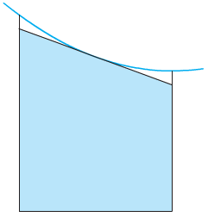
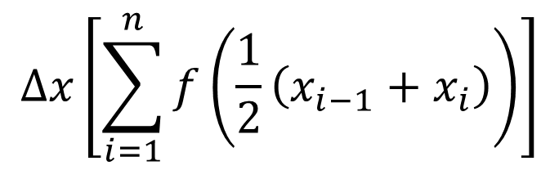
Midpoint Rule
Midpoint Rule results from finding the point between the right and left endpoints
$$∆x\left[\sum_{i=1}^{n}{f\left(\frac{1}{2}\left(x_{i−1}+x_{i}\right)\right)}\right]$$
f Concave Down
Midpoint Overestimates
f Concave Up
Midpoint Underestimates
Notes:
We can make several observations from Riemann Sum approximations:
1. In all of the methods we get more accurate approximations when we increase the value of n. (But very large values of n result in so many arithmetic operations that we have to beware of accumulated round-off error.)
2. The errors in the left and right endpoint approximations are opposite in sign and appear to decrease by a factor of about 2 when we double the value of n.
3. The Trapezoidal and Midpoint Rules are much more accurate than the endpoint approximations.
4. The errors in the Trapezoidal and Midpoint Rules are opposite in sign and appear to decrease by a factor of about 4 when we double the value of n.
5. The size of the error in the Midpoint Rule is about half the size of the error in the Trapezoidal Rule.

Slide 16
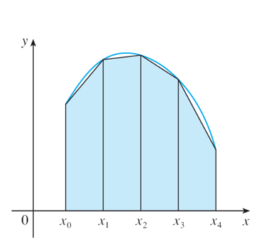
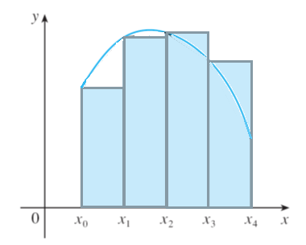
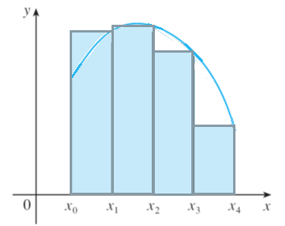
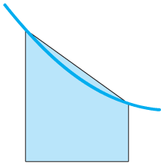
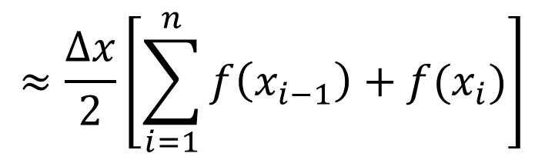
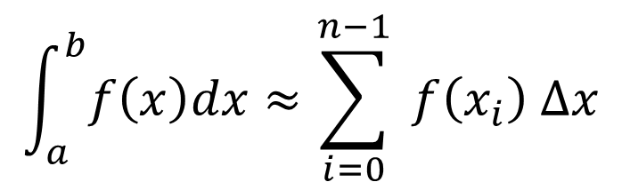
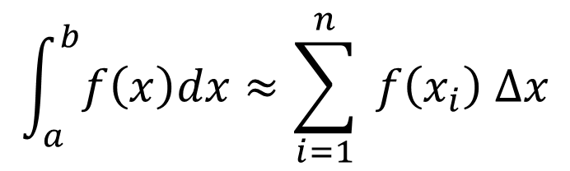
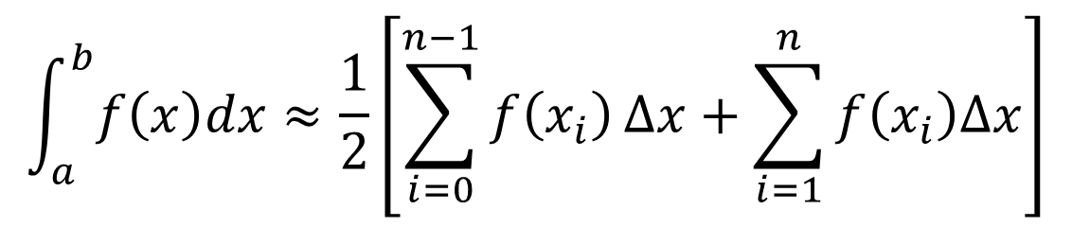
Trapezoid Rule
Trapezoidal Rule results from averaging the approximations of the Right and Left Rules:
$$\int_{a}^{b}{f\left(x\right)dx}≈\frac{1}{2}\left[\sum_{i=0}^{n−1}{f\left(x_{i}\right)}∆x+\sum_{i=1}^{n}{f\left(x_{i}\right)∆x}\right]$$
$$\int_{a}^{b}{f\left(x\right)dx}≈\sum_{i=0}^{n−1}{ f\left(x_{i}\right) ∆x}$$
$$\int_{a}^{b}{f\left(x\right)dx}≈\sum_{i=1}^{n}{ f\left(x_{i}\right) ∆x}$$
$$≈\frac{∆x}{2}\left[\sum_{i=1}^{n}{f\left(x_{i−1}\right)+f(x_{i})}\right]$$
f Concave Down
Trapezoid Underestimates
f Concave Up
Trapezoid Overestimates
Notes:
We can make several observations from Riemann Sum approximations:
1. In all of the methods we get more accurate approximations when we increase the value of n. (But very large values of n result in so many arithmetic operations that we have to beware of accumulated round-off error.)
2. The errors in the left and right endpoint approximations are opposite in sign and appear to decrease by a factor of about 2 when we double the value of n.
3. The Trapezoidal and Midpoint Rules are much more accurate than the endpoint approximations.
4. The errors in the Trapezoidal and Midpoint Rules are opposite in sign and appear to decrease by a factor of about 4 when we double the value of n.
5. The size of the error in the Midpoint Rule is about half the size of the error in the Trapezoidal Rule.

Slide 17
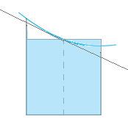
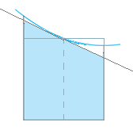
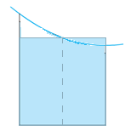
Under/Over Estimates
f Concave Down
Trapezoid Underestimates
f Concave Up
Trapezoid Overestimates
Midpoint
f Concave Down
Midpoint Overestimates
f Concave Up
Midpoint Underestimates

Slide 18
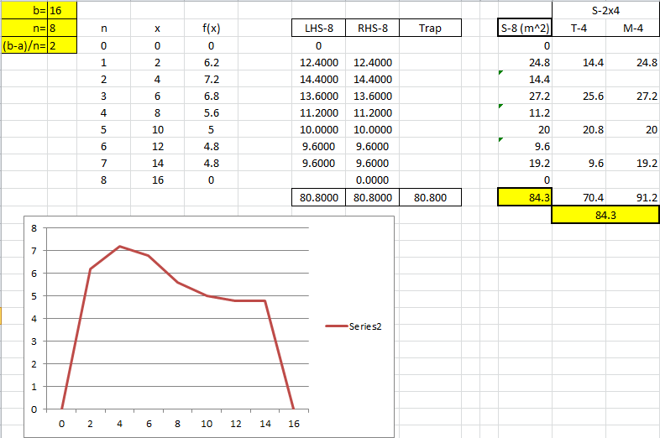
7.7 #30
Notes:
Book answer: approx 84
S-8 uses the column formula on page 513

Slide 19
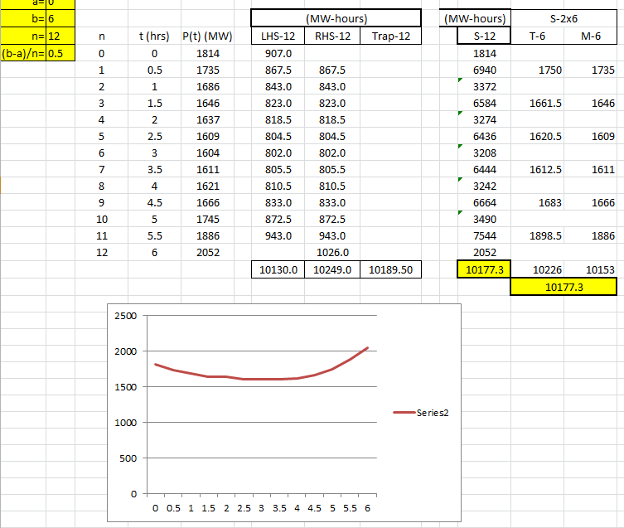
7.7 #37

Slide 20
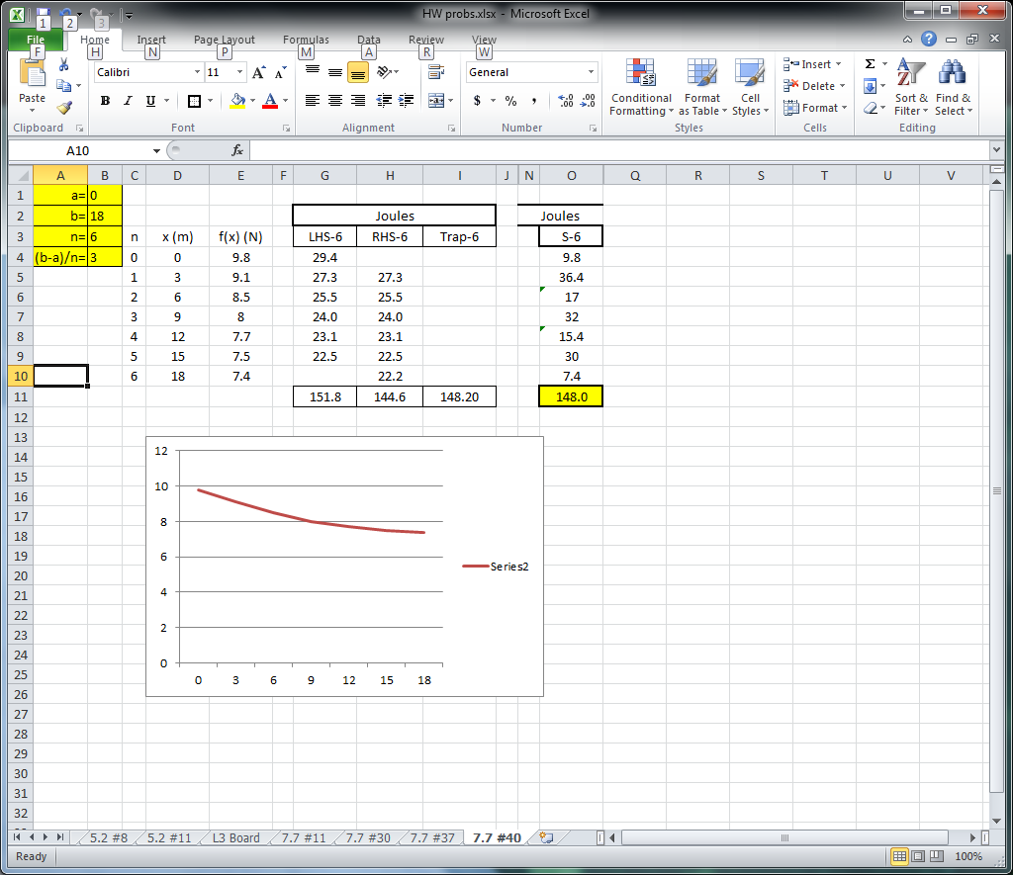
7.7, #40

